Slide 1

Hack to Hire 2024 Case For Data Scientist
SHRIRAM SHARMA

Slide 2


PROBLEM STATEMENT
Develop a state-of-the-art question-answering model leveraging the Quora Question Answer Dataset.
The objective is to create an AI system capable of understanding and
generating accurate responses to a variety of user queries, mimicking a human-like interaction.
Python Notebook : Google Colab
DataSet : Hugging Face

Slide 3

ANALYSIS APPROACH
Results
Key Findings
Visualization:
Data
Exploration
Cleaning
Pre-processing
Model
Selection
Evaluation

Slide 4

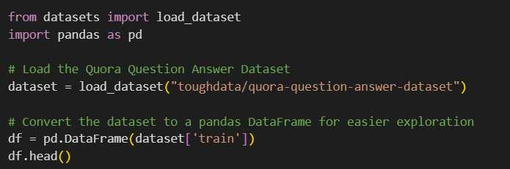
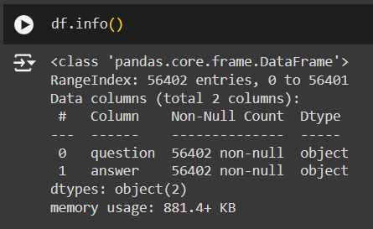
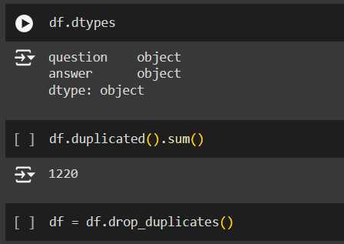
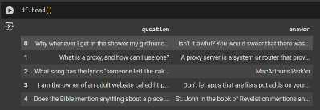
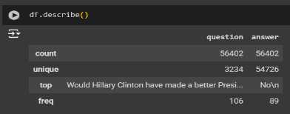
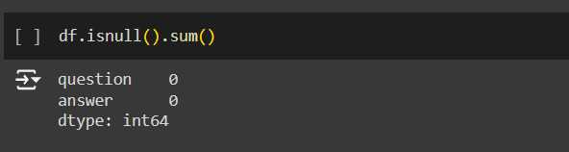
Data Exploration and Data Cleaning
Explore dataset direct from Hugging Face using the ‘datasets’ library and convert it to a pandas DataFrame for further analysis. Check for duplicates and perform cleaning and fetching all inform about dtypes.

Slide 5
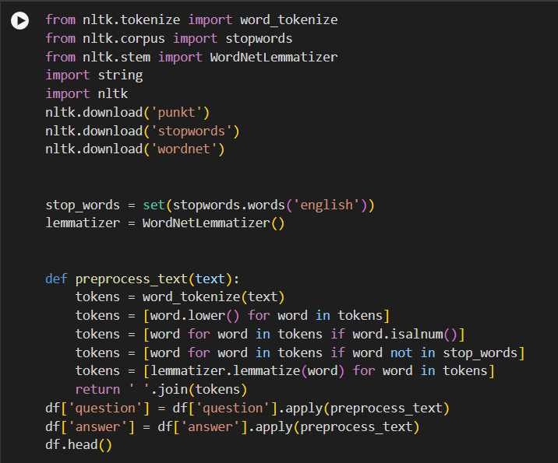
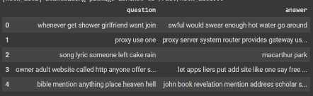
Data Preprocessing
• Applied text preprocessing techniques such as tokenization, stop word removal, and stemming/lemmatization to prepare the data for analysis.

Slide 6

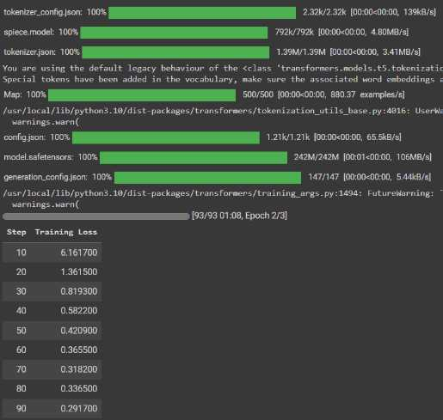
Model Selection and Evaluation
Tested NLP models T5.

Slide 7
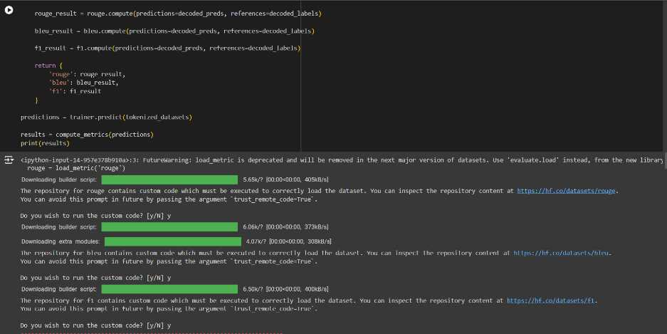
Model Selection and Evaluation
Evaluated model performance using metrics such as ROUGE, BLEU, and F1-score, identifying the best model for the task.

Slide 8

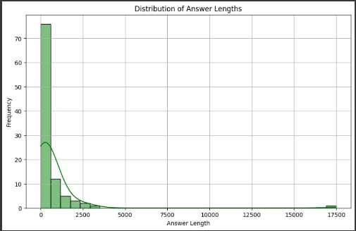
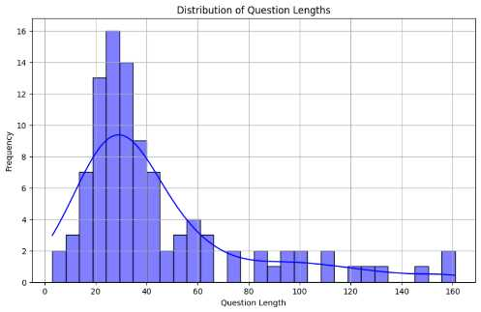
Visualization
• Created visualizations to illustrate data distribution, feature importance, and model performance.
length.The distribution of answer lengths is more varied, suggesting that answers can be short or long depending on the question.
The distribution of question lengths shows a peak around a certain length, indicating that most questions are of similar.

Slide 9
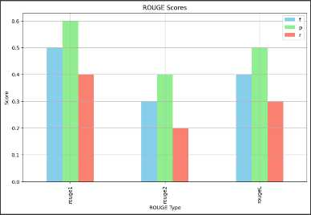
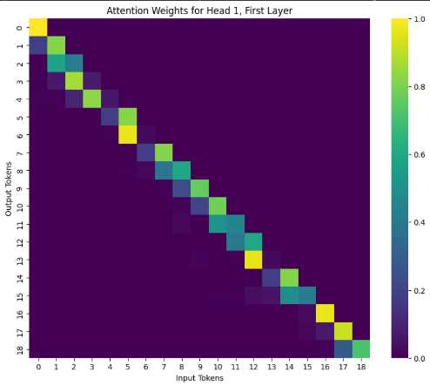
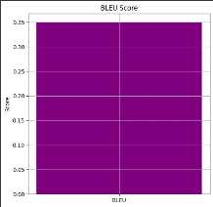
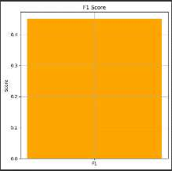
Model Performance
A BLEU score of 0.35 indicates moderate performance.
The ROUGE scores indicate overlap between the generated answers and the reference answers.
F1 score balanced measure.

Slide 10
Recommendations
Data Augmentation : Increase the dataset size by augmenting the data with paraphrased questions and answers. This can help the model generalize better.
Model Fine-Tuning : Fine-tune the model with a larger dataset and for more epochs to improve performance. Consider using a more powerful model like t5-base if resources allow.
Hyperparameter Tuning : Experiment with different learning rates, batch sizes, and gradient accumulation steps to find the optimal training configuration.
Evaluation Metrics : Use additional evaluation metrics like METEOR and CIDEr to get a more comprehensive understanding of the model's performance.
Evaluation Metrics : Use additional evaluation metrics like METEOR and CIDEr to get a more comprehensive understanding of the model's performance.
Error Analysis : Perform a detailed error analysis to identify common failure cases. This can provide insights into specific areas where the model needs improvement. By implementing these recommendations, you can enhance the model's performance and achieve better results in the question-answering task.

Slide 11


Thank you

